Slide 1
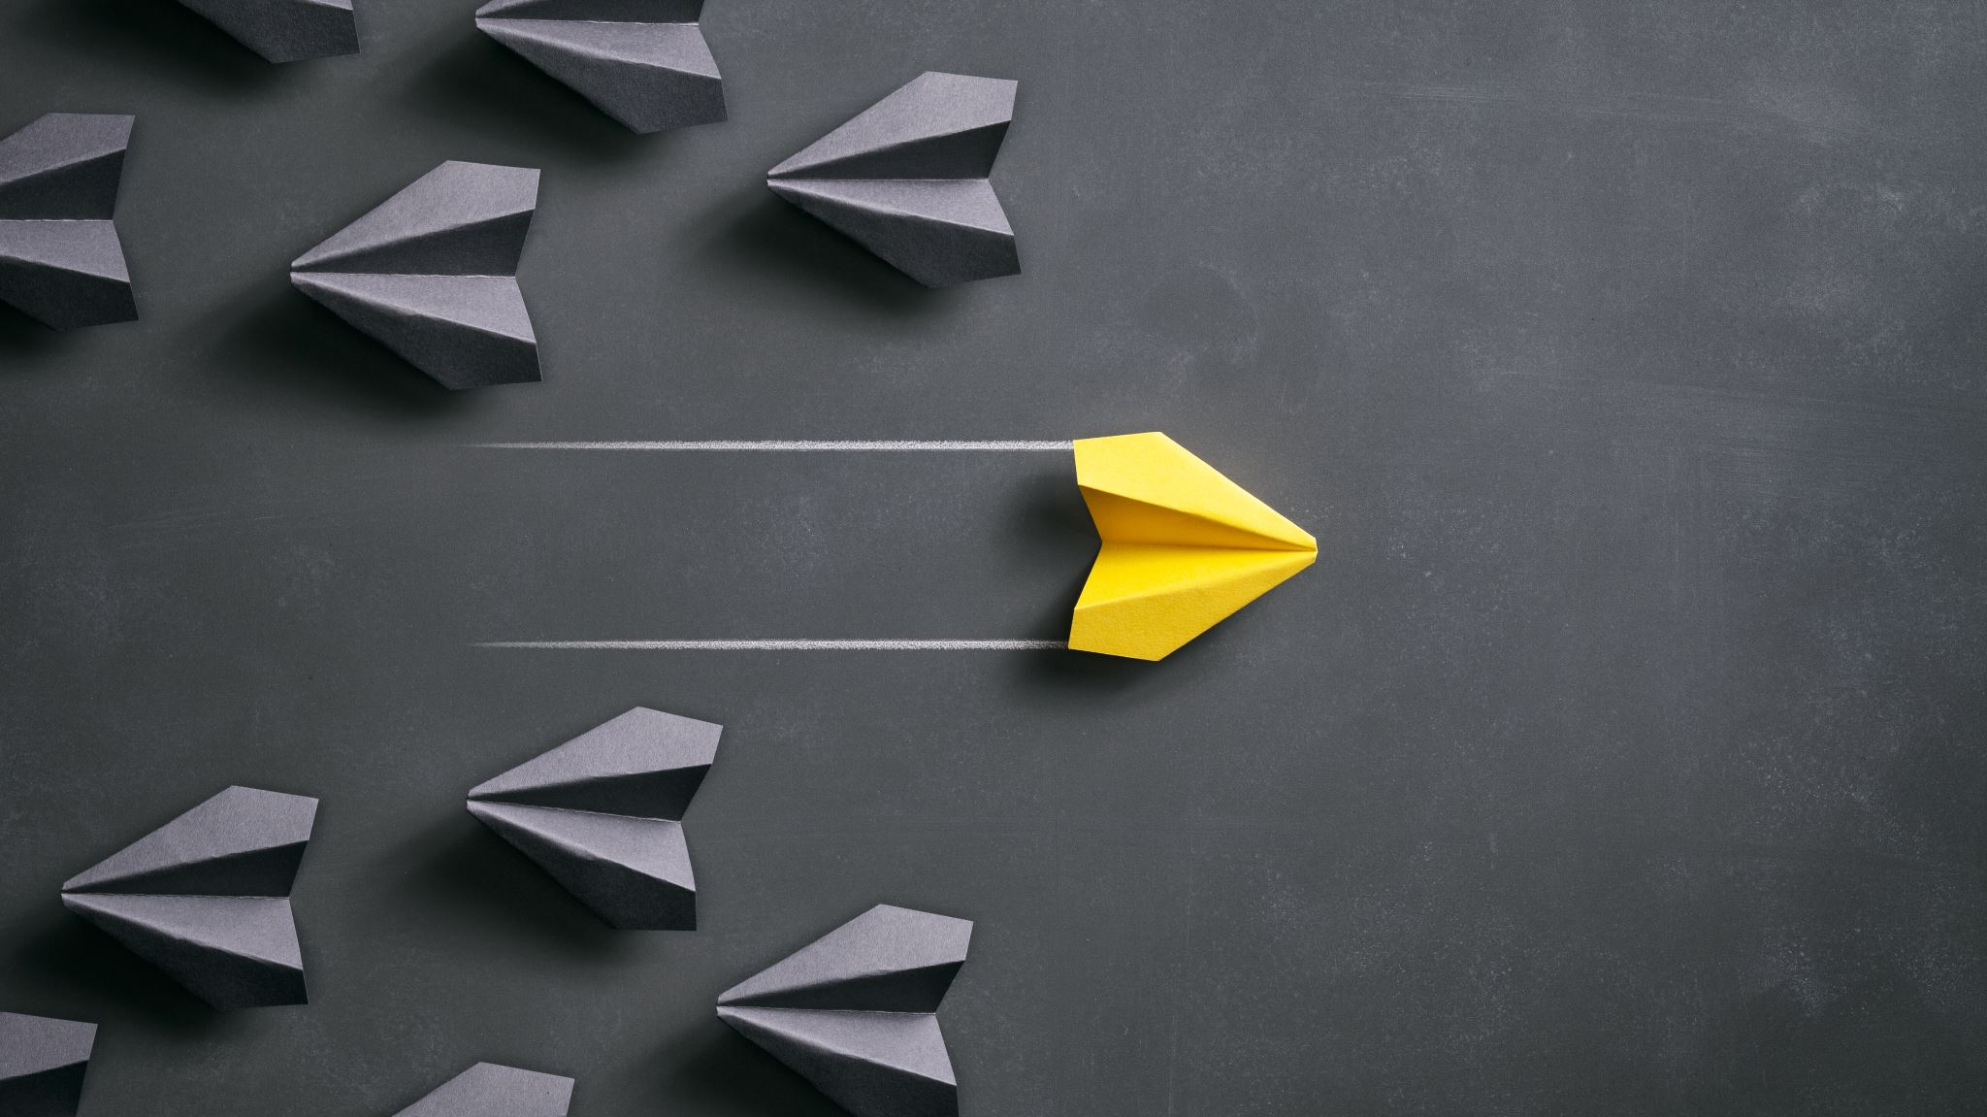
Separation Process II – Group 2
Team Members:
Ch Vinay Kumar : CH18BTECH11008
D Lakshmi Manohar : CH18BTECH11009
Prudhvi Naik : CH18BTECH11010
Hrithvin C : CH18BTECH11011
Hritik Sarkar : CH18BTECH11012

Slide 2
Distillation
Distillation is the process of separating the components or substances from a liquid mixture by using selective boiling and condensation.
Distillation may result in essentially complete separation (nearly pure components), or it may be a partial separation that increases the concentration of selected components in the mixture.
The application of distillation can roughly be divided into four groups: laboratory scale, industrial distillation, distillation of herbs for perfumery and medicinal (herbal distillate), and food processing.

Slide 3
Ponchon Savarit Method
This method was developed by the Ponchon and Savarit independently in the year 1921-1923.
Rigorous and capable of handling all distillations but requires detailed enthalpy data for its application.
Simultaneous material and energy balance calculations.
Detailed calculations of equilibrium conditions.
More accurate, but difficult to use Largely superseded by rigorous computer simulation calculations.

Slide 4
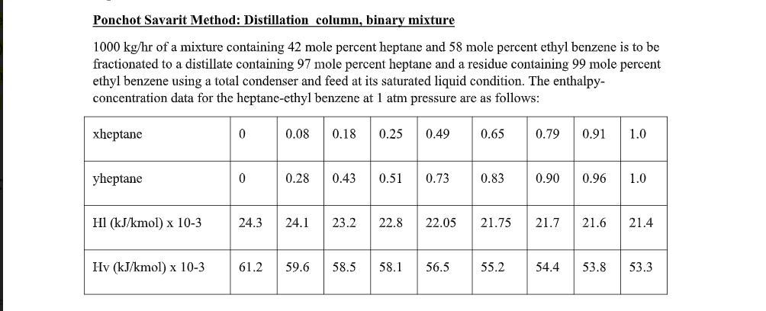
Problem definition
****This problem statement has been taken from the tutorial question****

Slide 5
Governing Equations.
Variables:
Liquid flow rate across plates : L_{n}
Vapor flow rate across plates :V_{n+1}
Mole ratio in vapor and liquid phase of each tray :y_{n+1 ,} x_{n}
Molar enthalpy of vapor and liquid phase across each tray : H_{Vn+1} , H_{Ln} .
Constants:
Reflux ratio (R) , Top and Lower product flow rate (D & W) and their respective mole ratios(x_{d} , x_{w}) , Heat Duties (Qb,Qd), Feed Flow rate (F, z_{f}) .

Slide 6
Rectifying Section:
V_{n+1} = L_{n} + D
V_{n+1}*y_{n+1} = L_{n}*x_{n} + D*x_{d}
V_{n+1}*H_{Vn+1} = L_{n}*H_{Ln} + Qd’
y = interp1(xe, ye, x_{n})
H_{Ln} = interp1(xe, Hl, x_{n} )
H_{Vn+1} = interp1(ye, Hv, y_{n+1})

Slide 7
Stripping Section:
V_{m+1} = L_{m} - W
V_{m+1}*y_{m+1} = L_{m}*x_{m} - W*x_{W}
V_{m+1}*H_{Vm+1} = L_{m}*H_{Lm} - Qc’
y = interp1(xe, ye, x_{m})
H_{Lm} = interp1(xe, Hl, x_{m} )
H_{Vm+1} = interp1(ye, Hv, y_{m+1})

Slide 8
Flowchart for graphical Ponchon savarit:
Enthalpy concentration H_v vs y and H_l vs x are drawn.
Energy and Material balance we get points D_dash,S_dash.
From the proof of colleniarity we get that D_dash,(H_ln,x_n),(H_vn+1,Y_n+1) are on the same line.
Joining the points Q_dash and D we get Y_1.

Slide 9
From the Y_1 using euillibrium data we get x_1.
From collinearity principle joining point L_1 and D_dash we get Y_2.
Repeat till it crosses the feed line and rectifying section is done.
Joining the W and S_dash we get y_n and using equillibrium data we get x_n , same repeated as rectifying section.

Slide 10
Flowchart for Numerical ponchon savarit:
Calculate y_1,H_l0,H_v1,L_0,V_1 from xd for the first tray using fsolve.
Calculate x_1 from y_1 by interpolating from the equilibrium curve.
Use this x_1, to solve for y_2,H_l1,H_v2,L_1,V_2 using
Material balance, component balance, energy balance, Hv-y , Hl-x equations.
Again we get x_2 by interpolation from equilibrium curve. We go on doing like this till the feed tray.

Slide 11
When we go past the feed tray, the governing equations will change but the procedure will remain the same.
The main problem we faced is when we tried to write the equations for a particular tray. the material balance, component balance, energy balance equations required y_n+1 and x_n whereas the equilibrium relation is valid between y_n and x_n. We tackled the problem by using a global variable i.e. we are sending x_n from the previous iteration to be used in the current iteration in equilibrium relation

Slide 12

Approach:
Step1:
Using the classic Ponchon-Savarit method we created the heat map .
Step2:
Finding out the number of the stages and feed plate tray from the classic Ponchon-Savarit.
Step3:
Based on the number of stages and the feedplate entry we write the equations for each stage.
For each stage we know 'x' value (which we get from previous stage or for 1st stage it will be xd) and then there are 5 variables (unknowns) y,Hl,Hv,L,V which will be solved by fsolve. Then we can find x for next stage from equillibrium curve using y from current stage.
Writing the material balance, component balance, energy balance, HL-x curve, Hv-y curve and x-y curve we get the required equations to solve the variables we have

Slide 13
Approach
Step 4:
At each stage using fsolve to solve the set of the equations we get 5 variables solution.
Using equillibrium curve function we get x using y.
Step 5:
Same process is repeated till we reach the feed plate, till this step we use rectifying section equations.
Step 6:
After crossing the feed plate now the same process is repeated for stripping section using stripping section equations.
Step 7:
After collecting values of x,y,H_l,H_v,V,L at each stage we draw a heat map and compare it with the heat map that we got using simple Ponchon-Savarit.
Find the code below explained with the comments at each line:

Slide 14
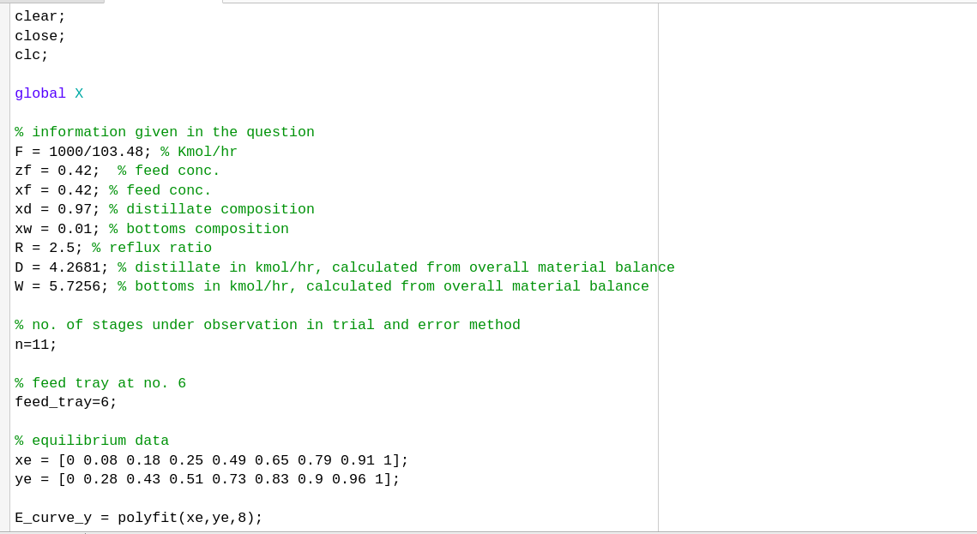

Slide 15
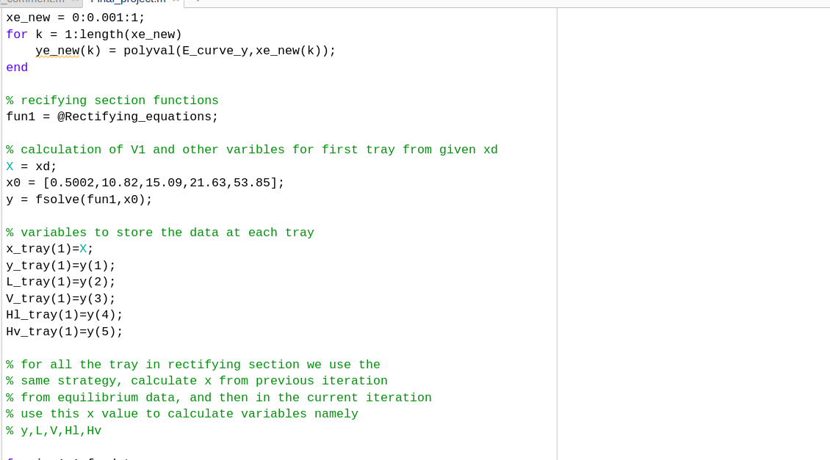

Slide 16
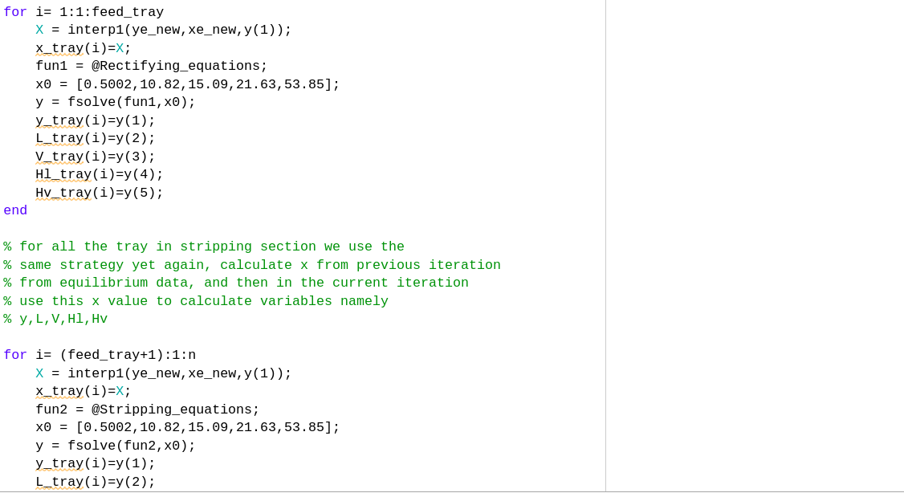

Slide 17
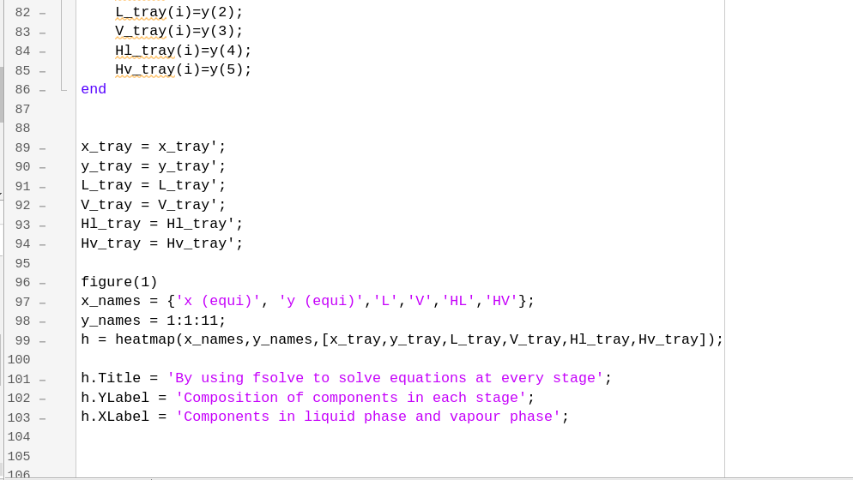

Slide 18
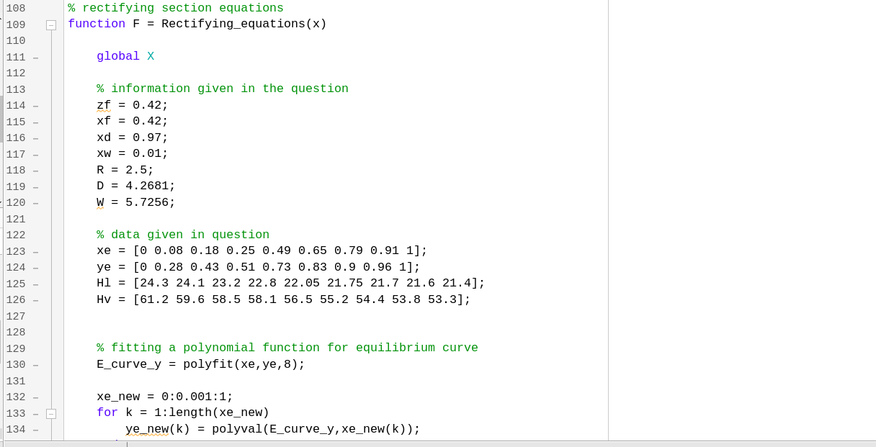

Slide 19
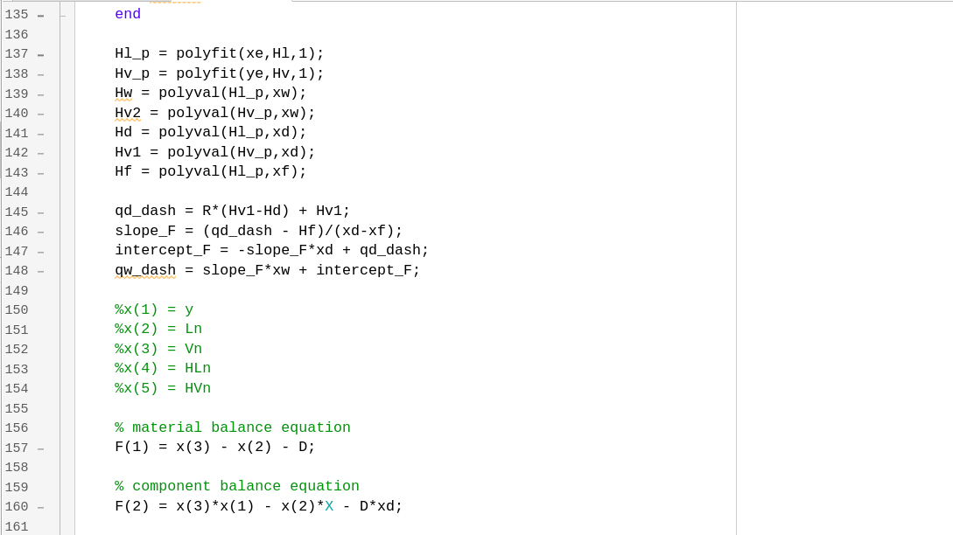

Slide 20
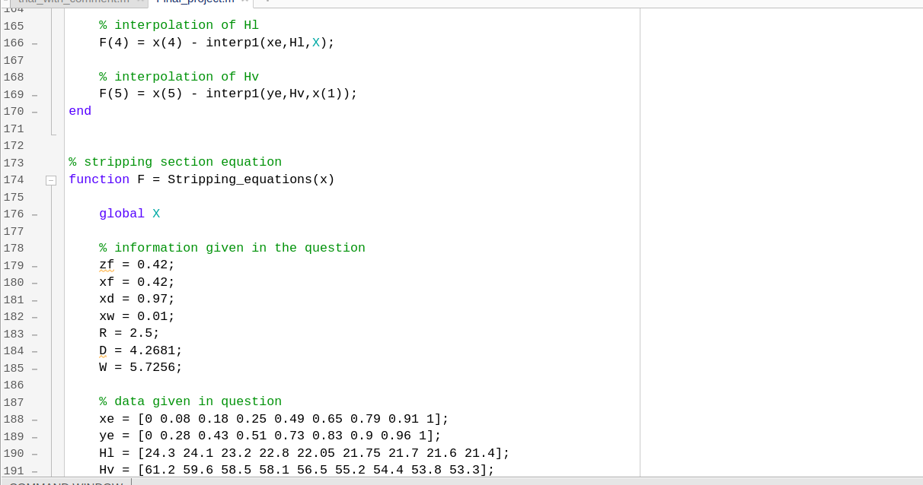

Slide 21
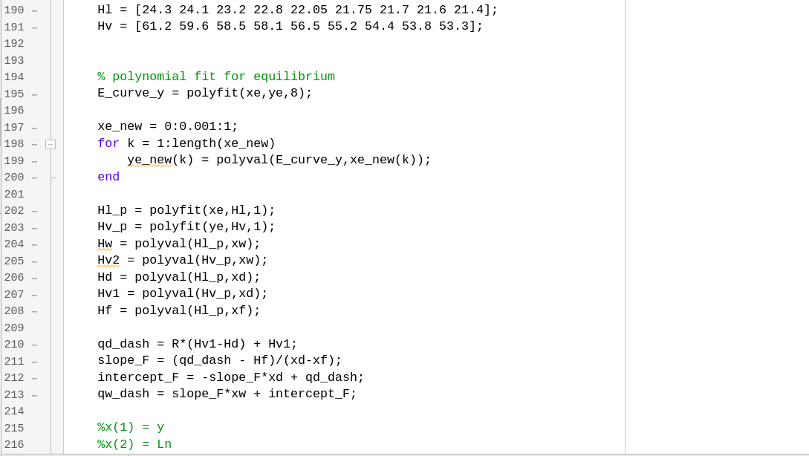

Slide 22
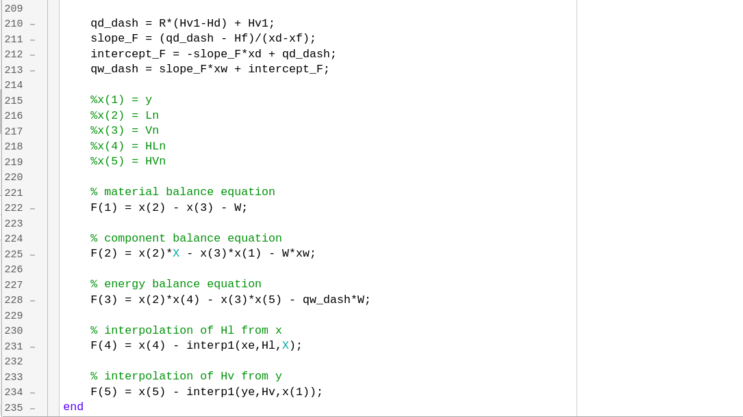

Slide 23
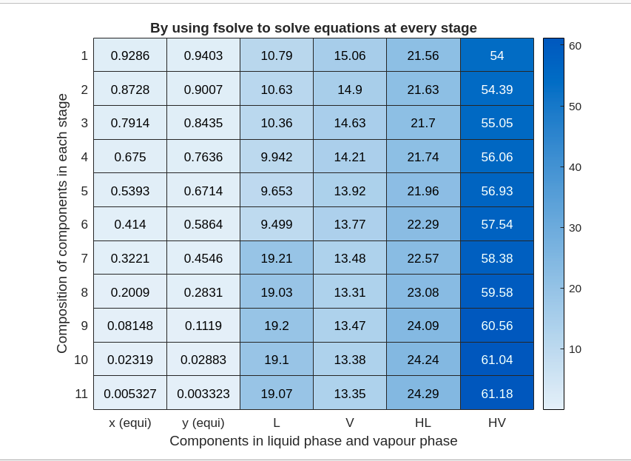
Heat map Using our code

Slide 24
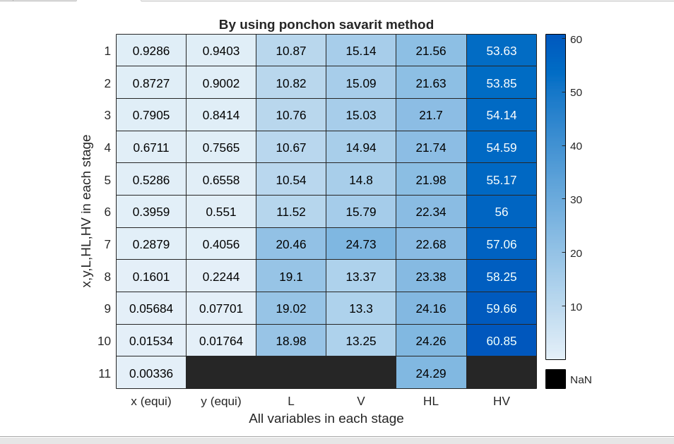
Heat map using classical ponchon savarit

Slide 25

Conclusion
By comparing the heat maps from numerical and graphical ponchon savarit method (above two pictures) we conclude that our approach produce the results close to the ponchon

Slide 26
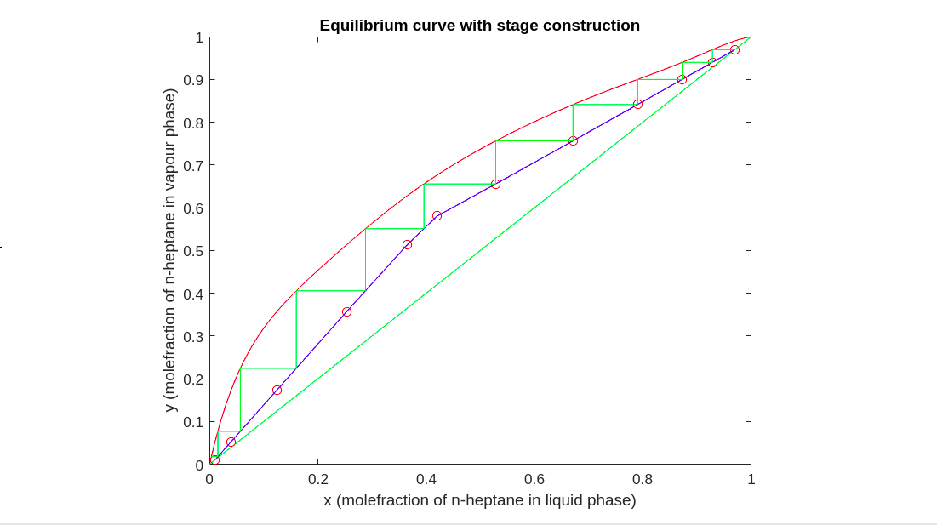

Slide 27
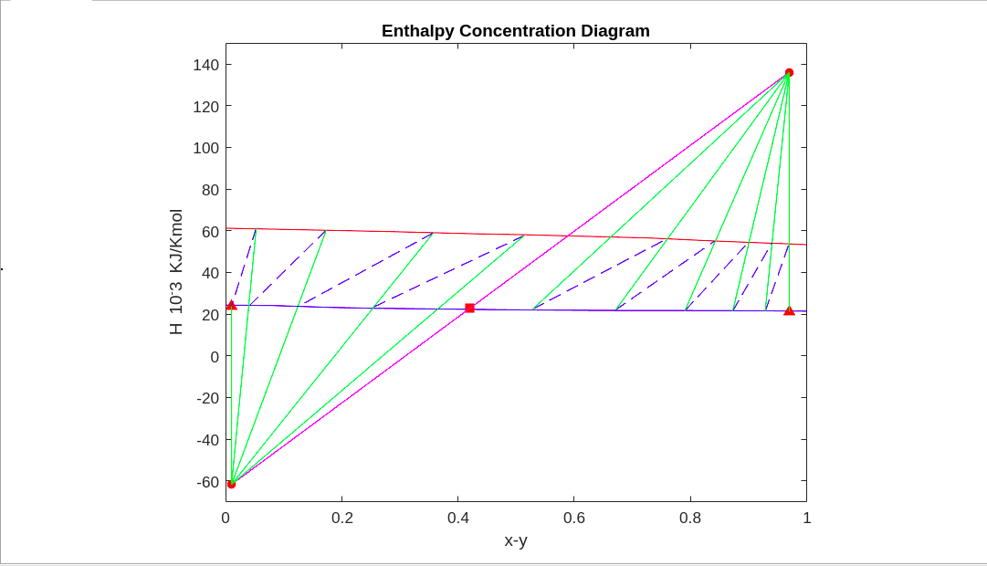

Slide 28
fsolve function in matlab:
Given a set of n nonlinear functions Fi(x), where n is the number of components in the vector x, the goal of equation solving is to find a vector x that makes all Fi(x) = 0. fsolve attempts to solve a system of equations by minimizing the sum of squares of the components. If the sum of squares is zero, the system of equations is solved. fsolve has three algorithms:
Trust-region
Trust-region-dogleg
Levenberg-Marquardt
The details of these can be found in the below source:
https://in.mathworks.com/help/optim/ug/equation-solving-algorithms.html#brrx7_e-1
fin

